Slide 1


Exploratory Data Analysis (EDA) in Python
- Spotify Dataset -
Python for Data Science Mini Project
Objective : To understand the dataset, uncover underlying patterns, and generate insights that could guide further analysis or decision-making.
Select a dataset
Perform data cleaning
Pre-processing,
Conduct exploratory data analysis (EDA)
Present the findings
By Group-3
Abhijith S D
Arvind C R
Ayyasamy S
Gurumurthy Kalyanpur Viswanathaiah
Manjunath

Slide 2



Dataset Selection
Reason for choosing this dataset: We scanned Kaggle and several other platforms to find a dataset that meets our objectives. The chosen dataset was agreed upon by all project members and possesses the necessary complexity, making it more realistic for our needs. This includes handling scenarios with missing values, sorting through relevant and irrelevant data, managing different data types, and addressing inconsistencies in the format.
The dataset is consists of 29 columns and 4599 rows with diverse information :
Dataset is about most streamed Spotify songs in 2024
🎵 Track
📀 Album Name
🎤 Artist
📅 Release Date
🔢 ISRC
📈 All Time Rank
⭐ Track Score
🎧 Spotify Streams
📋 Spotify Playlist Count
🌐 Spotify Playlist Reach
🎼 Spotify Popularity
📹 YouTube Views
👍 YouTube Likes
🎥 TikTok Posts
💖 TikTok Likes
👁️ TikTok Views
🎵 YouTube Playlist Reach
🍏 Apple Music Playlist Count
📻 AirPlay Spins
📡 SiriusXM Spins
🎶 Deezer Playlist Count
🌍 Deezer Playlist Reach
📚 Amazon Playlist Count
🎙️ Pandora Streams
📻 Pandora Track Stations
🔊 Soundcloud Streams
🕵️ Shazam Counts
🎶 TIDAL Popularity
🔞 Explicit Track

Slide 3
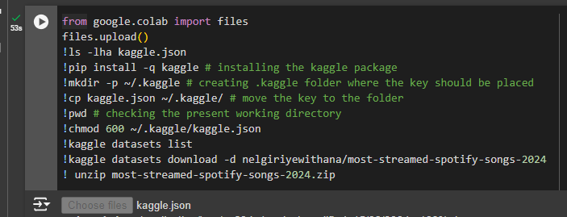
Project Setup
Setup :
Worked on cloud platform (Placing related files at Github) and use Kaggle API connection to connect to Google Colab platform for executing the project. This setup made easy to work together while we parallelly use Jupyter notebook as local version for individual trials/analysis & observations.
Steps taken:
📈 Data Setup linking kaggle and google colab
📰 Read the kaggle API token to interact with your kaggle account
⚙️ Series of commands to set-up for download
♿ Giving rw (read-write) access
✅ Sanity check if able to access kaggle
⬇️ Download data command
🤐 Unzip Dataset
📚 Libraries Used 🔧
🔬 chardet
Purpose: Determine the encodings of files
Usage: To understand the charset of the kaggle dataset
😶 missingno
Purpose: Missing data visualization module for Python.
Usage: To visualize the null values easily
🐍 Pandas
Purpose: Data manipulation and analysis.
Usage: To handle and process data, including reading and cleaning the dataset.
📊 Seaborn
Purpose: Statistical data visualization.
Usage: To create informative and attractive visualizations such as histograms, pair plots, and violin plots.
🖼️ Matplotlib
Purpose: Plotting and visualization.
Usage: For creating static, animated, and interactive visualizations, including histograms and plots with customized styles.
📈 Plotly
Purpose: Interactive data visualization.
Usage: To create interactive plots and visualizations that allow for deeper exploration of the data.
⚠️ Warnings
Purpose: Manage warnings.
Usage: To suppress warnings that may clutter the output.
README File for Reference:

Slide 4
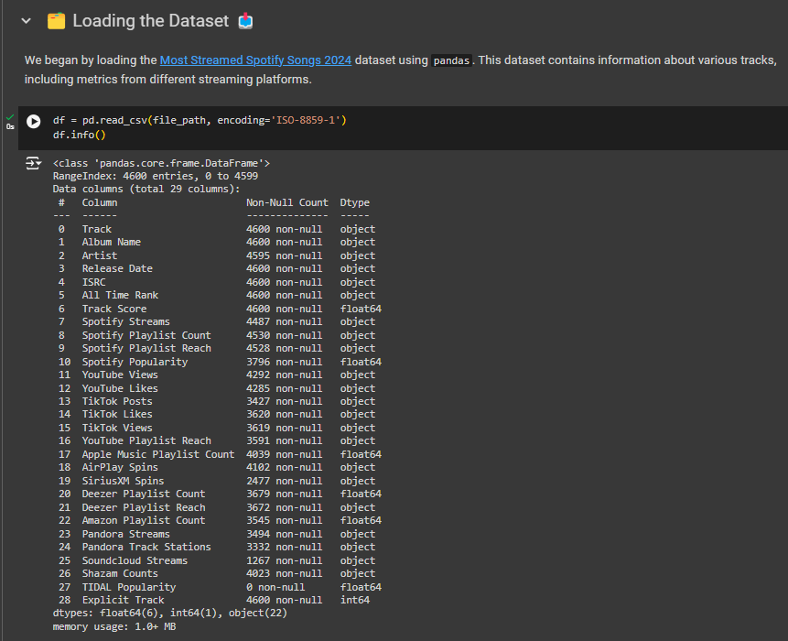
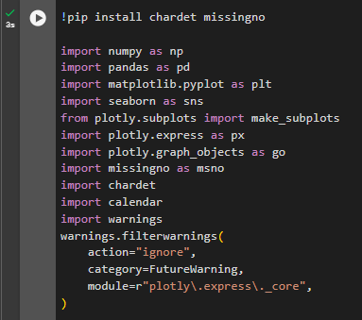
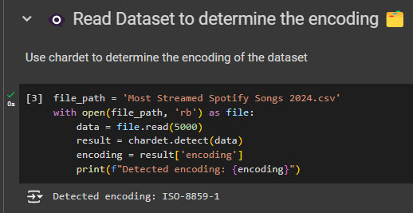
Data Import and Cleansing
Imported the necessary libraries: pandas, numpy, matplotlib, seaborn, etc.
Loaded the dataset into a pandas Data Frame.

Slide 5
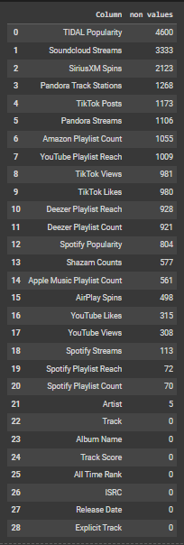
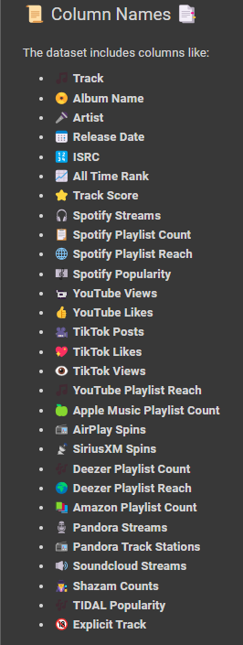
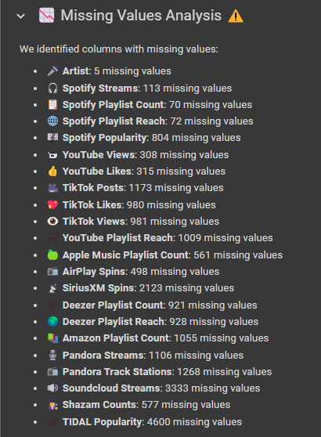
Data Import and Cleansing – Null Values Analysis

Slide 6
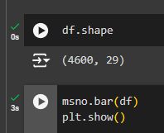
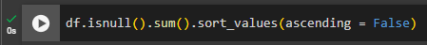
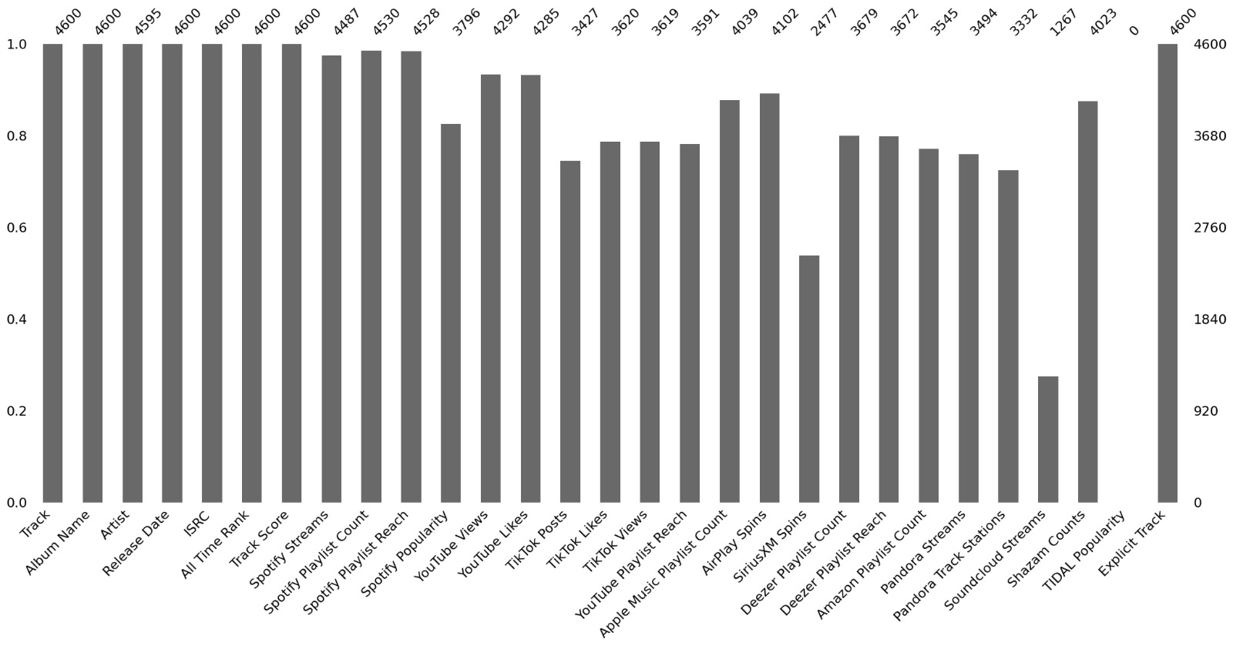
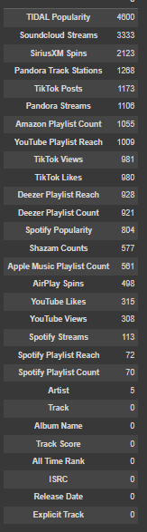
Data Import and Cleansing
Performed initial data inspection: checked the shape of the data, data types, and summary statistics.

Slide 7
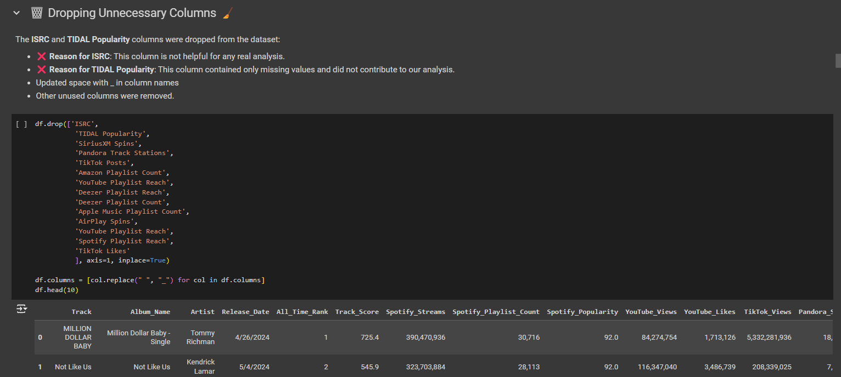
Data Import and Cleansing
Identify and handle missing values. Decide whether to drop, fill, or interpolate missing data based on the context.
Detect and remove duplicate rows if any.
Convert data types if necessary (e.g., dates should be in datetime format).

Slide 8
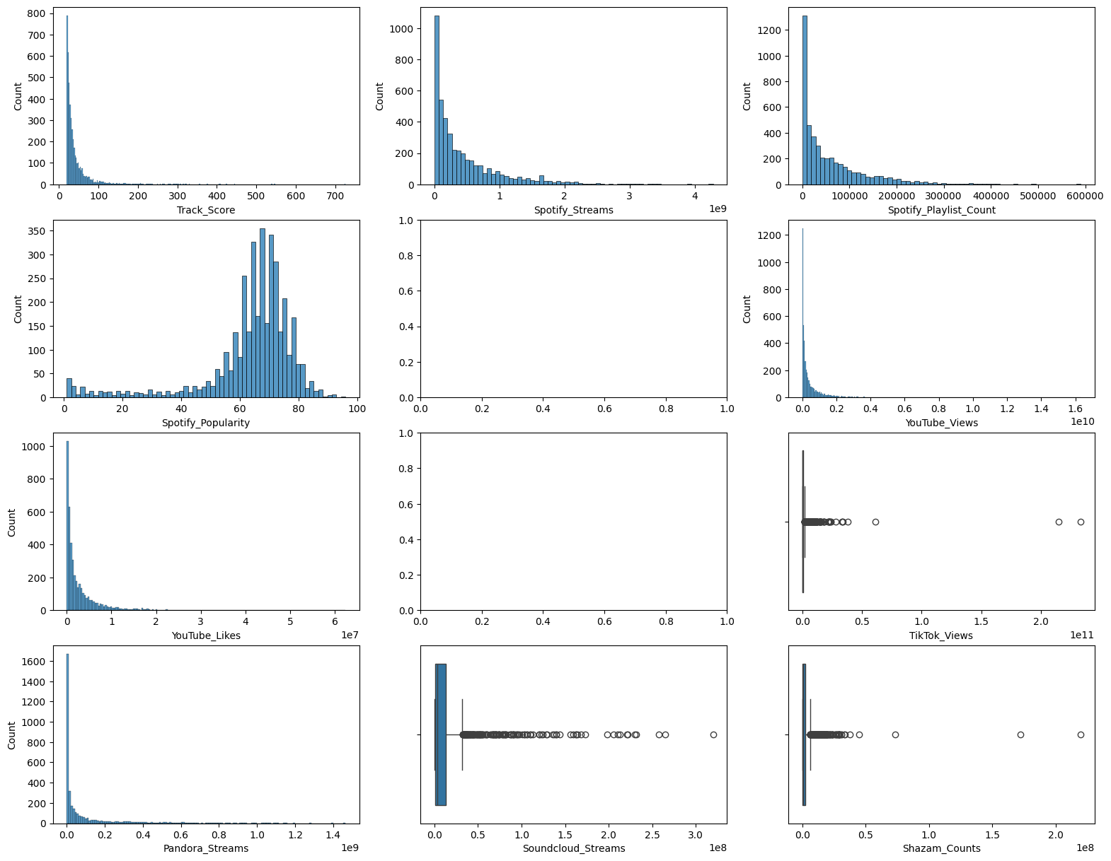
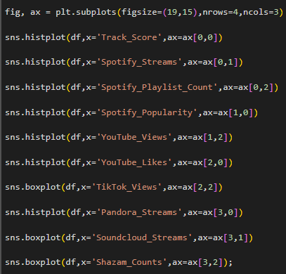
Numeric columns analysis
Spotify_Popularity has 2 tails
All Other columns are positively skewed
TikTok_Views, Soundcloud_Streams and Shazam_Counts have lot of outliers
Use of Histogram
and Box Plots for feature analysis

Slide 9
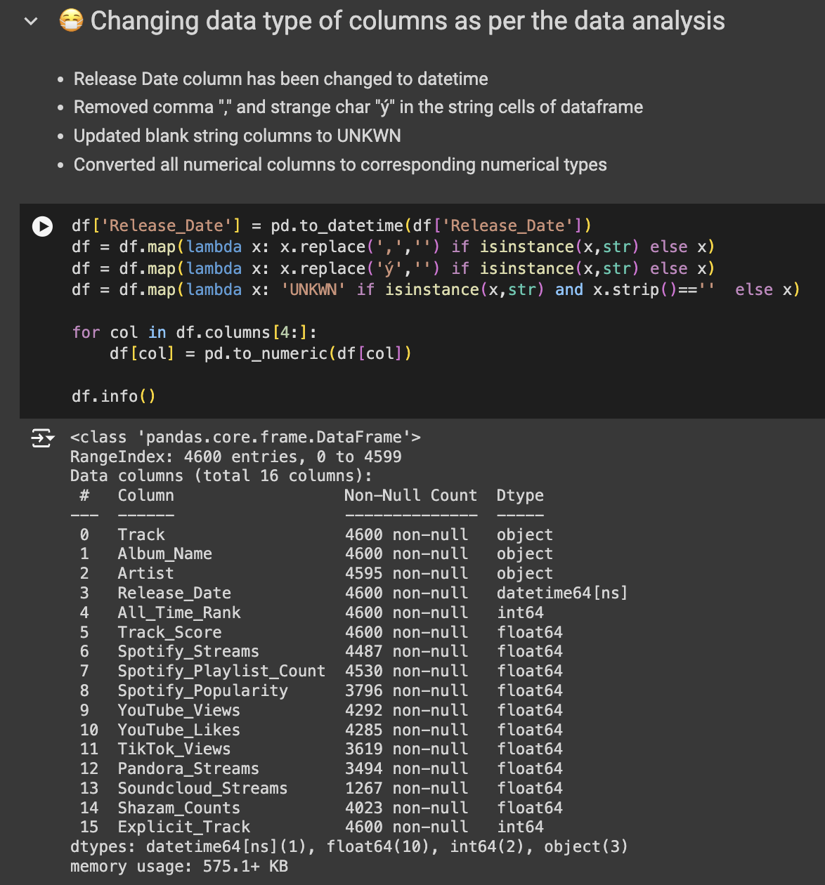
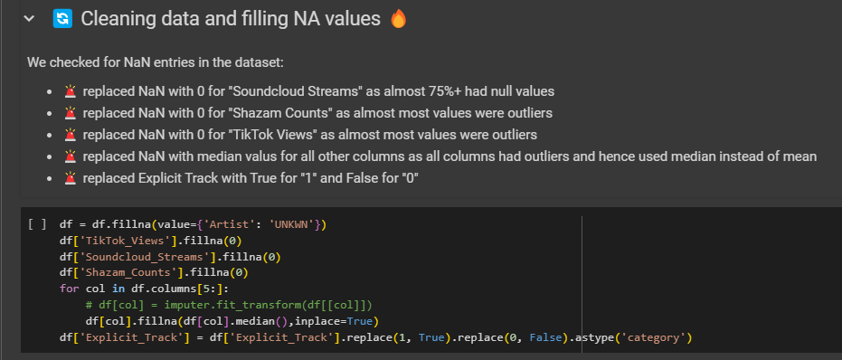
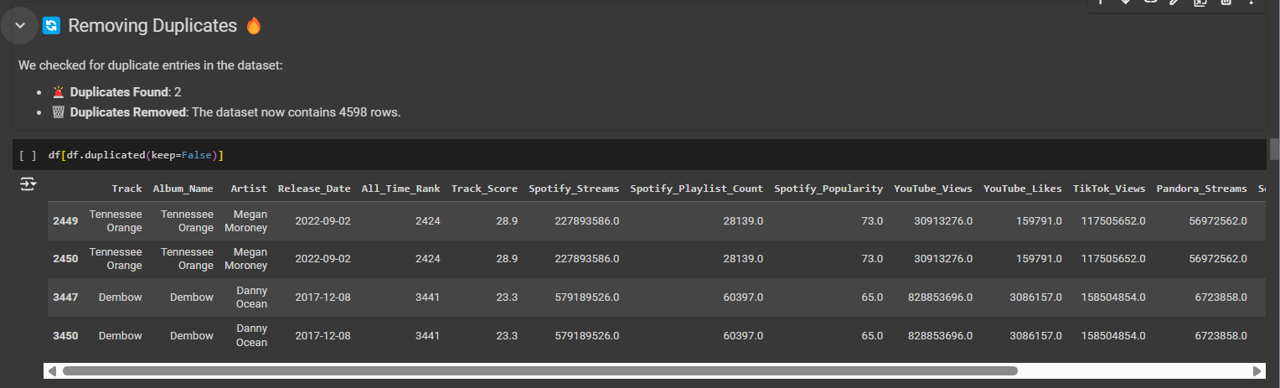
Data Import and Cleansing
Use of Lambda Function

Slide 10
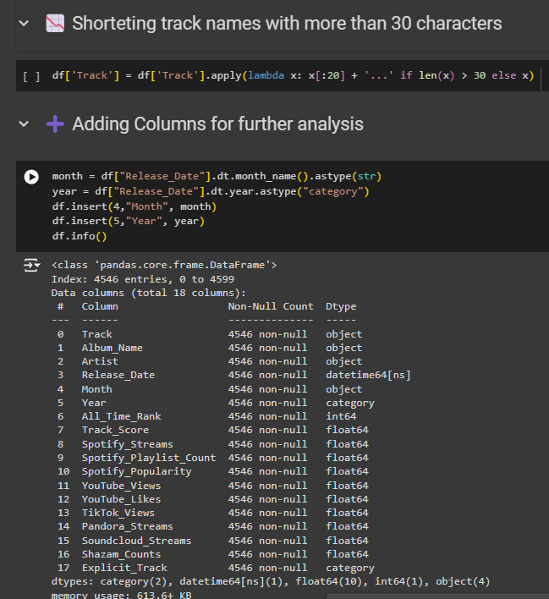
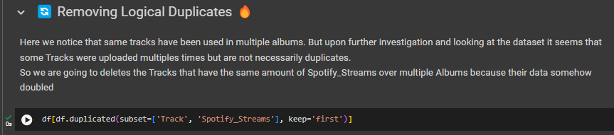
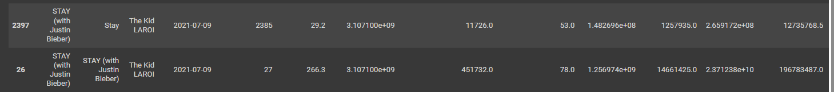
Data Import and Cleansing

Slide 11
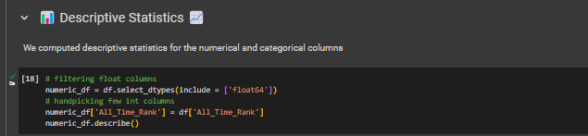
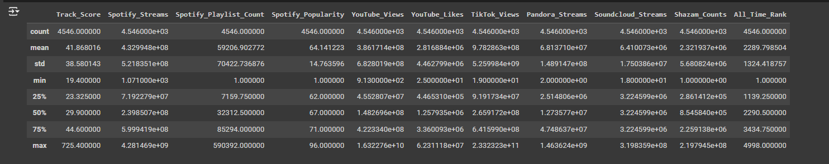
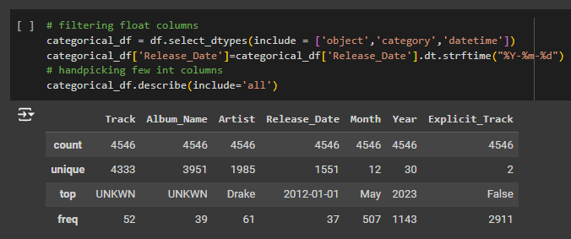
Exploratory Data Analysis (EDA)
Descriptive Statistics:
Provide summary statistics for numerical columns (mean, median, standard deviation, etc.).
Provide summary statistics for categorical columns (frequency counts, unique values, etc.).

Slide 12
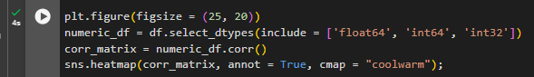
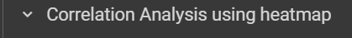
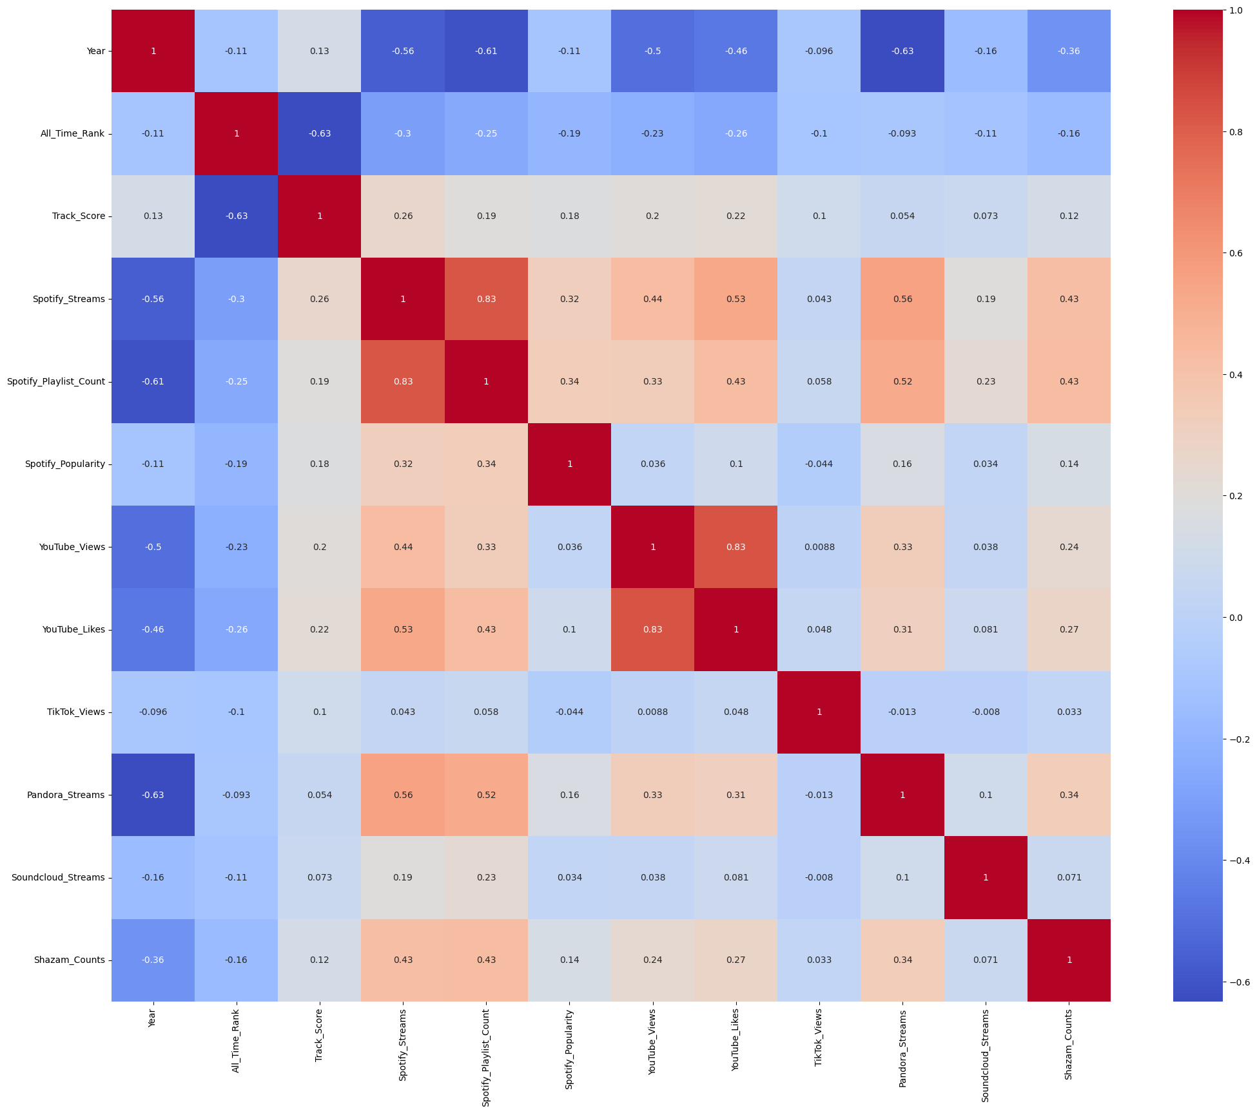
Exploratory Data Analysis (EDA) - Visualization
Feature analysis

Slide 13
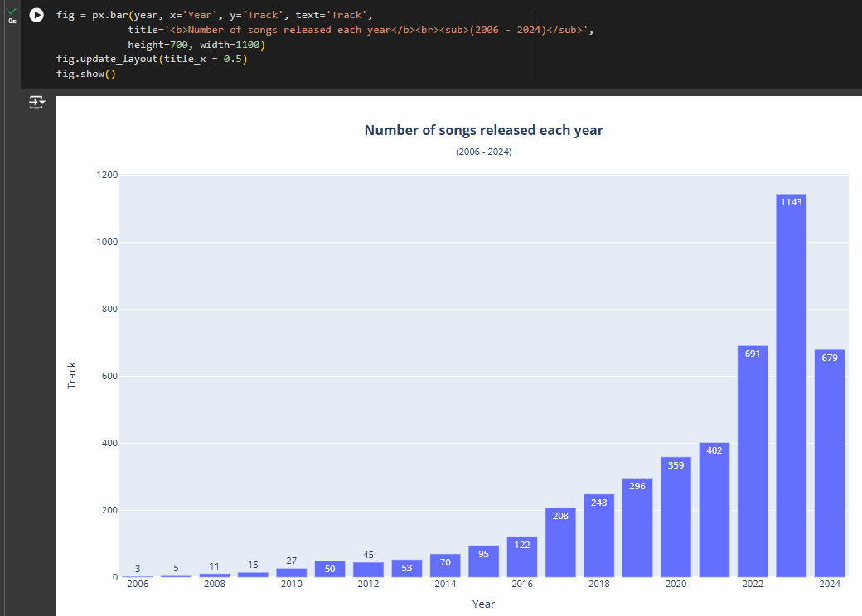
Exploratory Data Analysis (EDA) - Visualization

Slide 14
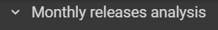
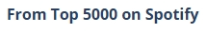
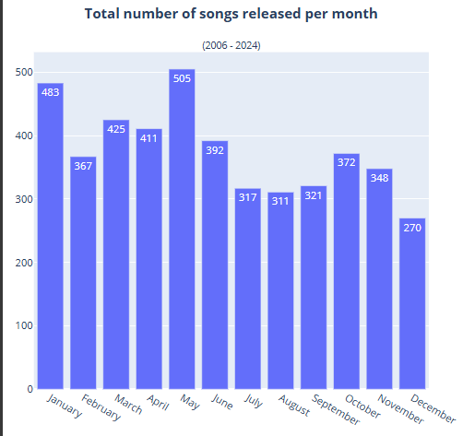
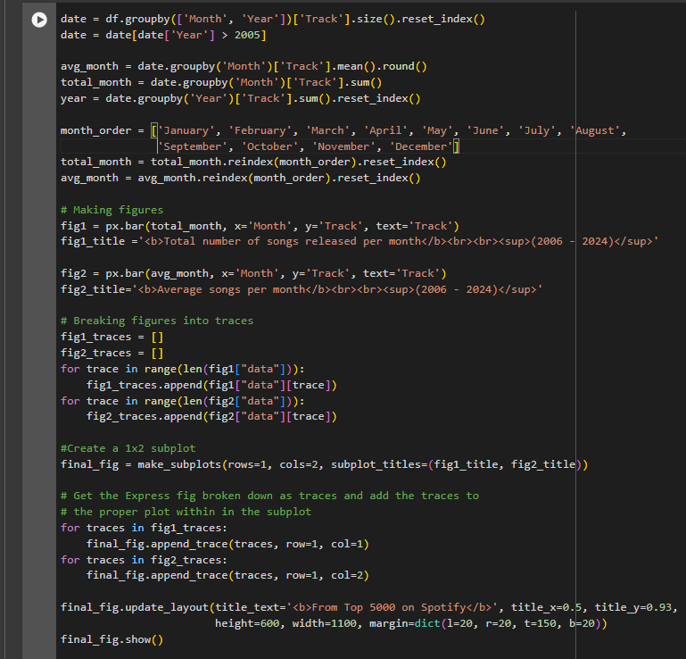
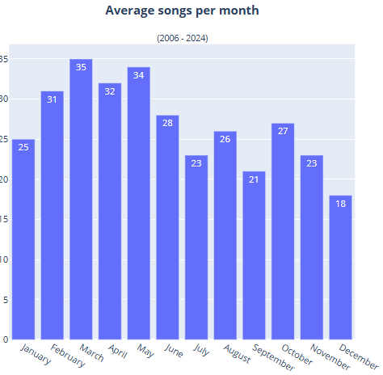
Exploratory Data Analysis (EDA) - Visualization

Slide 15
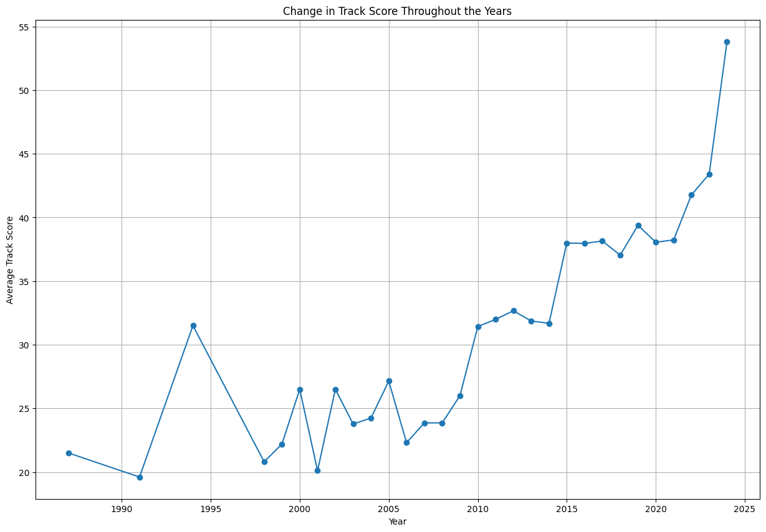
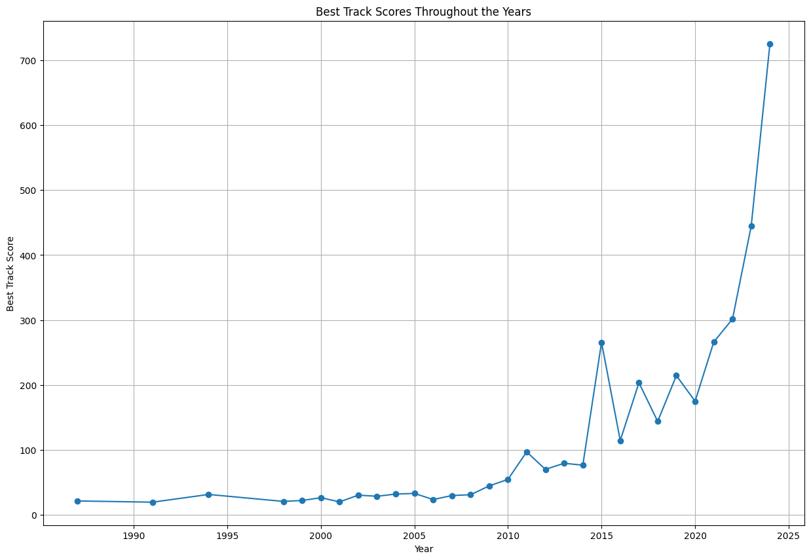
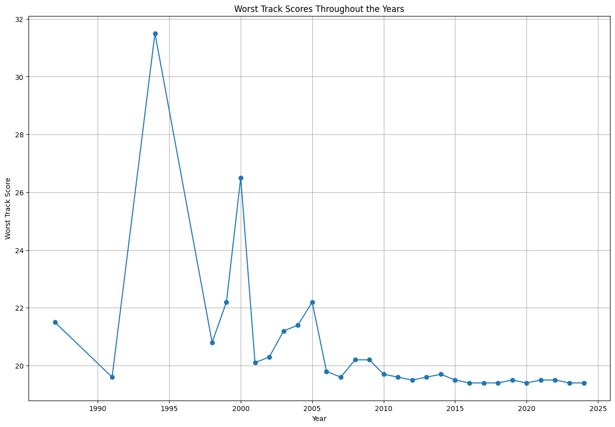
Exploratory Data Analysis (EDA) - Visualization
Track Score Analysis
Avg Track Score
Best Track Score
Worst Track Score
Track Quality Improvement

Slide 16
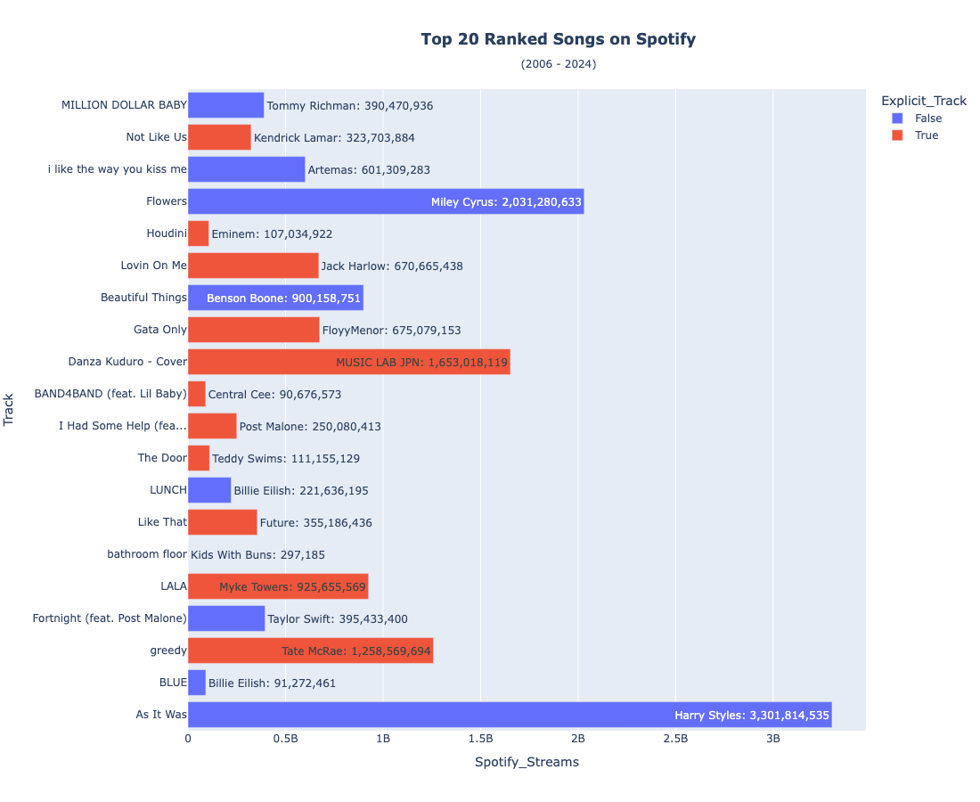
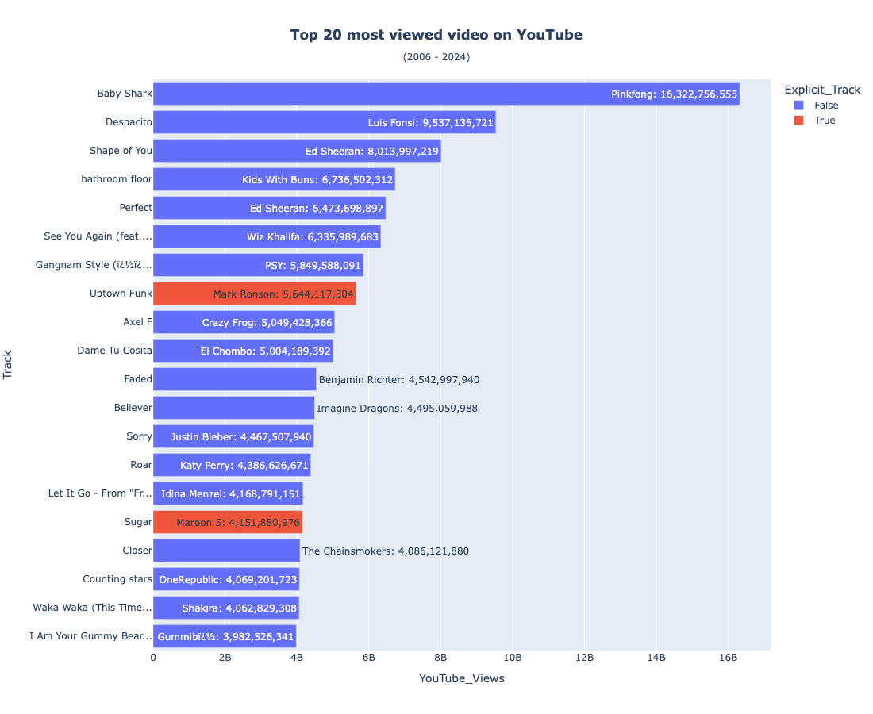
Exploratory Data Analysis (EDA) - Visualization
Platform Popularity

Slide 17
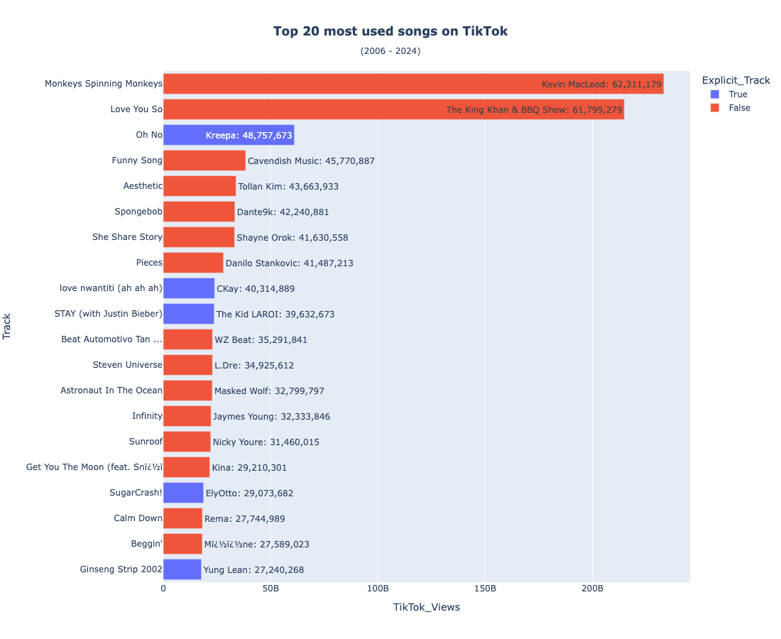
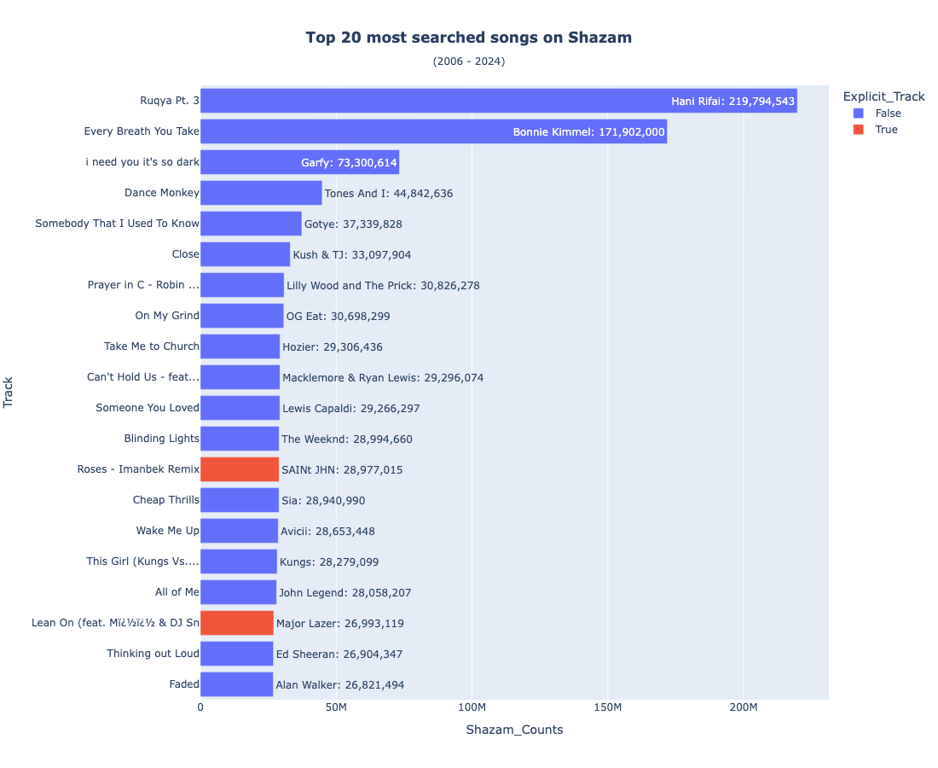
Exploratory Data Analysis (EDA) - Visualization
Platform Popularity

Slide 18
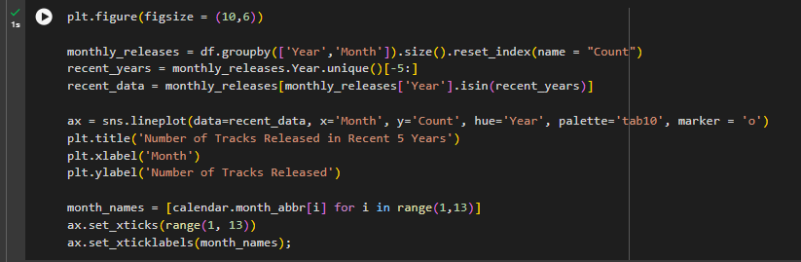
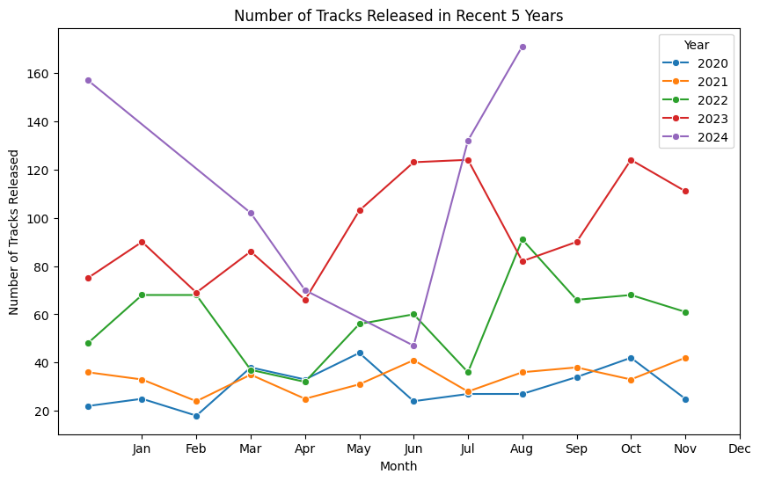
Exploratory Data Analysis (EDA) - Visualization
Group By Analysis by year

Slide 19
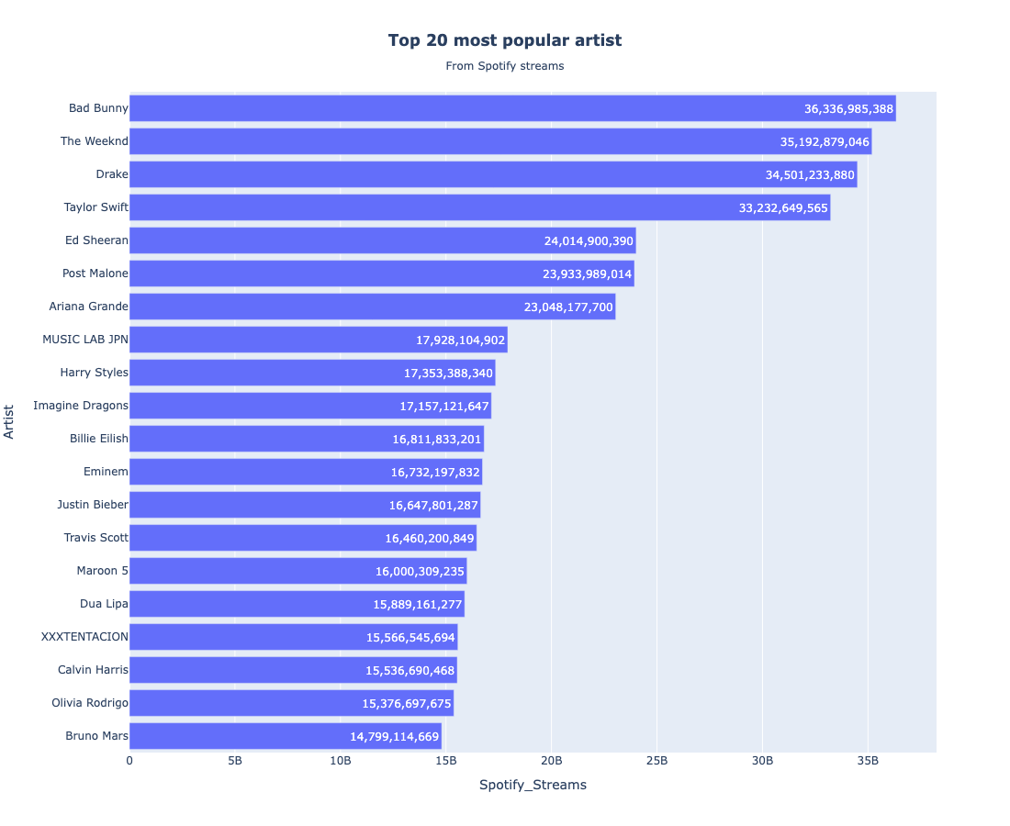
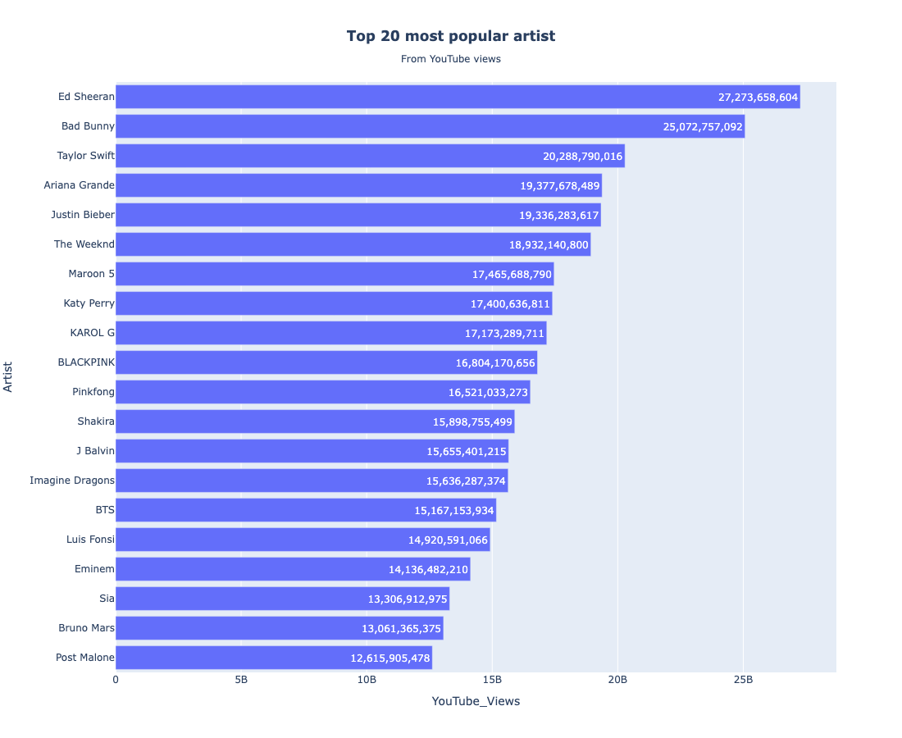
Exploratory Data Analysis (EDA) - Visualization
Group By Analysis By Artist

Slide 20

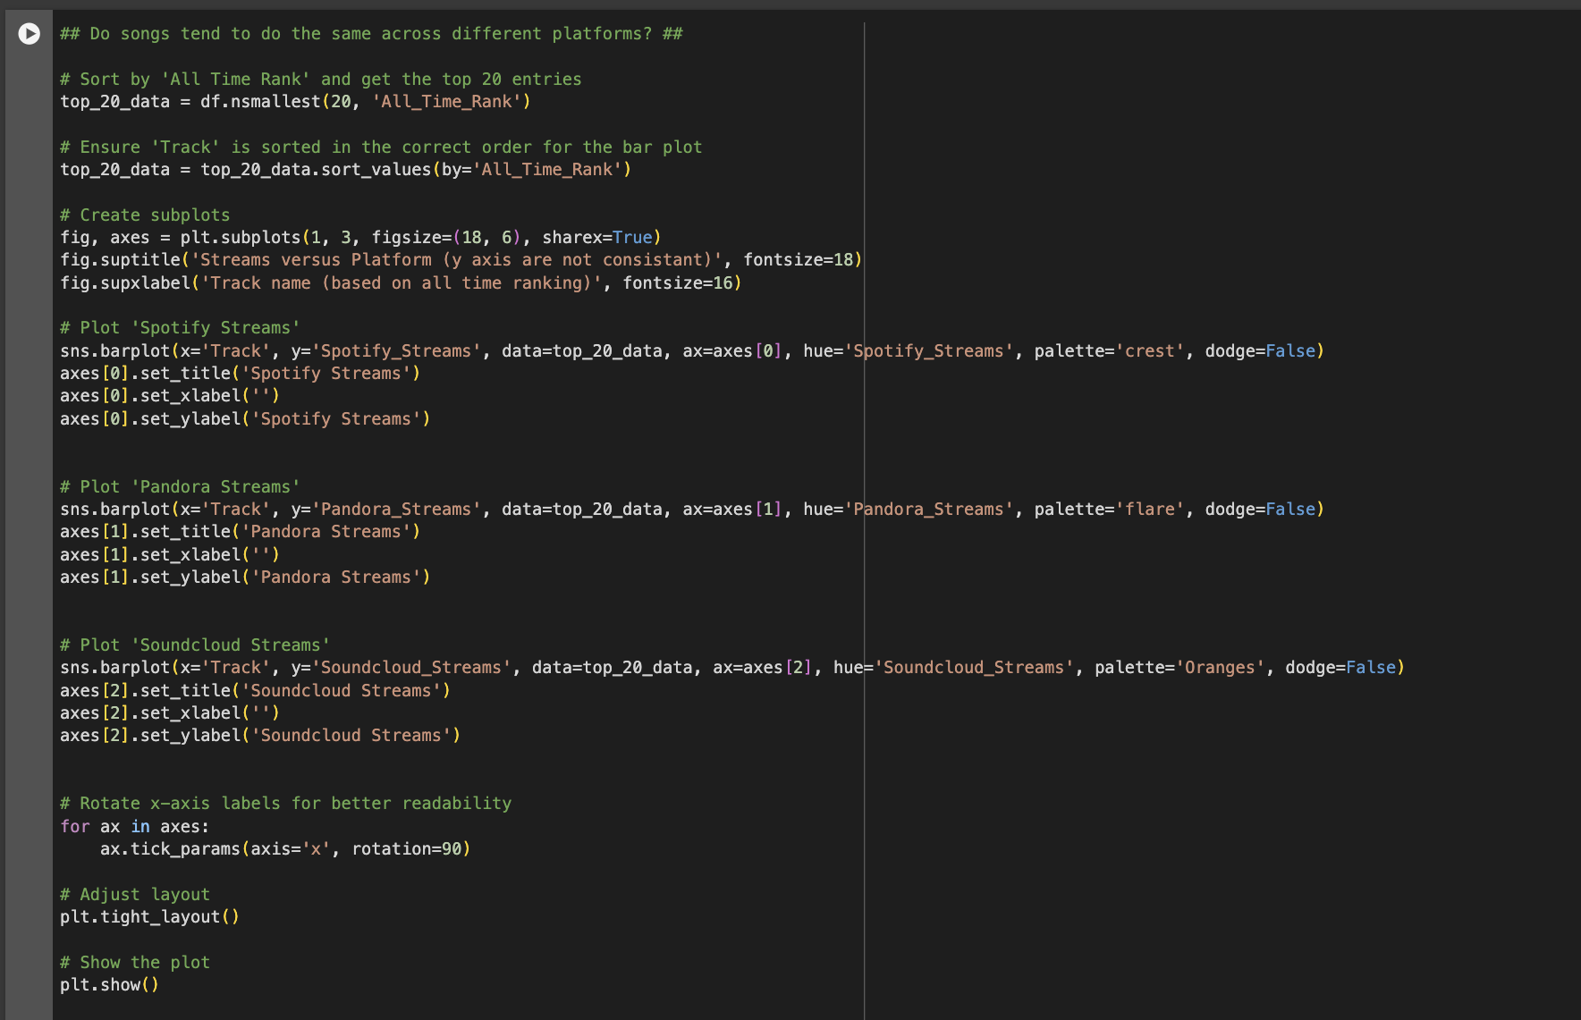
Stream Analysis

Slide 21
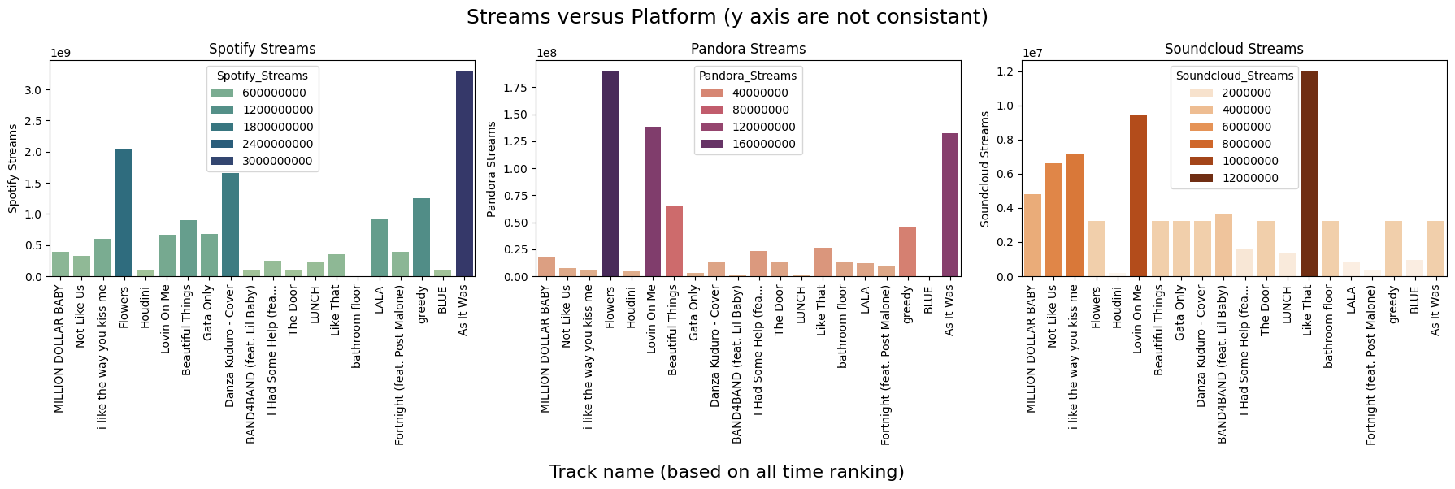
Stream Analysis - Visualization

Slide 22
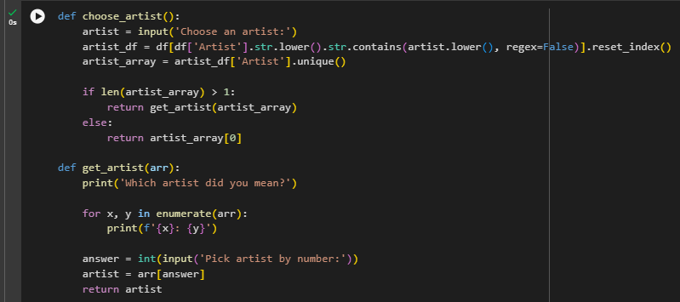
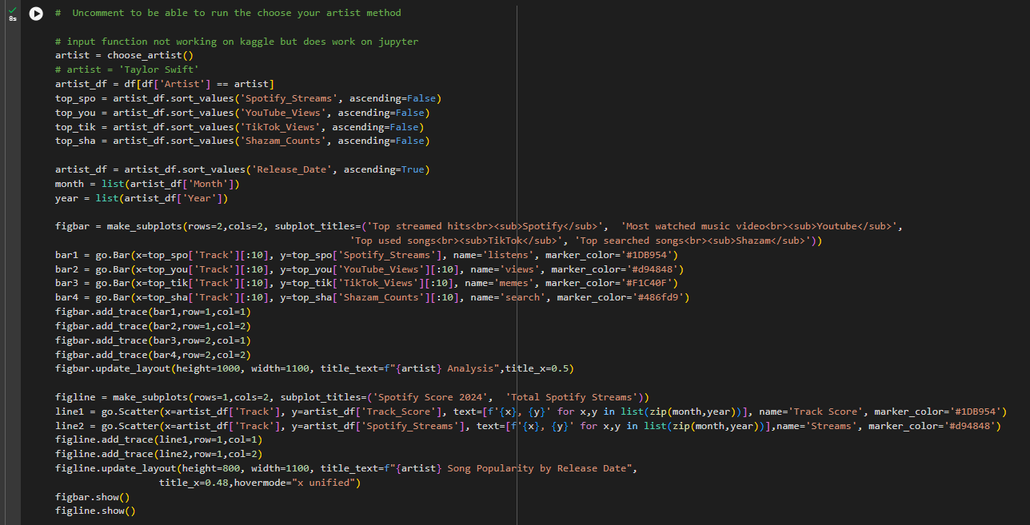
Choose Artist to Analyse
User Defined Function

Slide 23
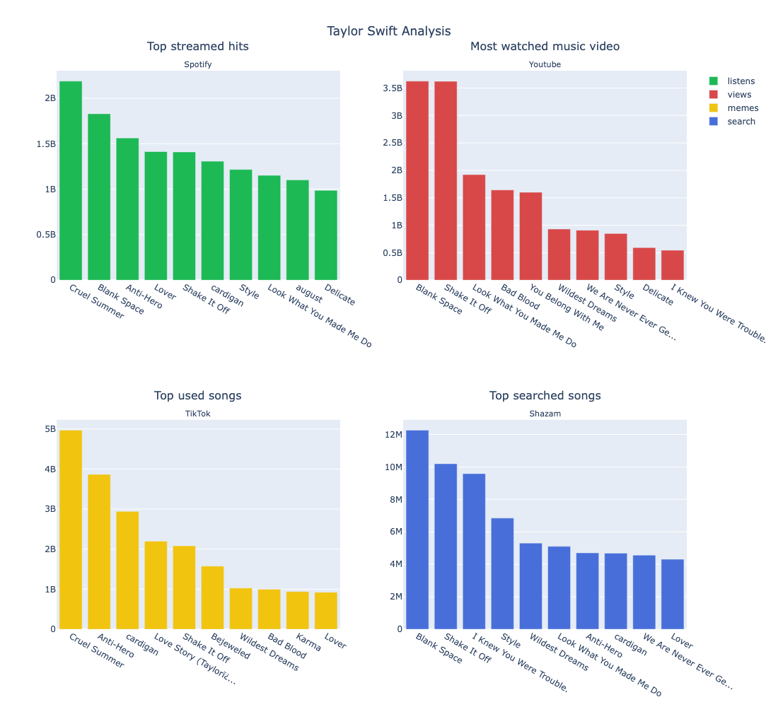
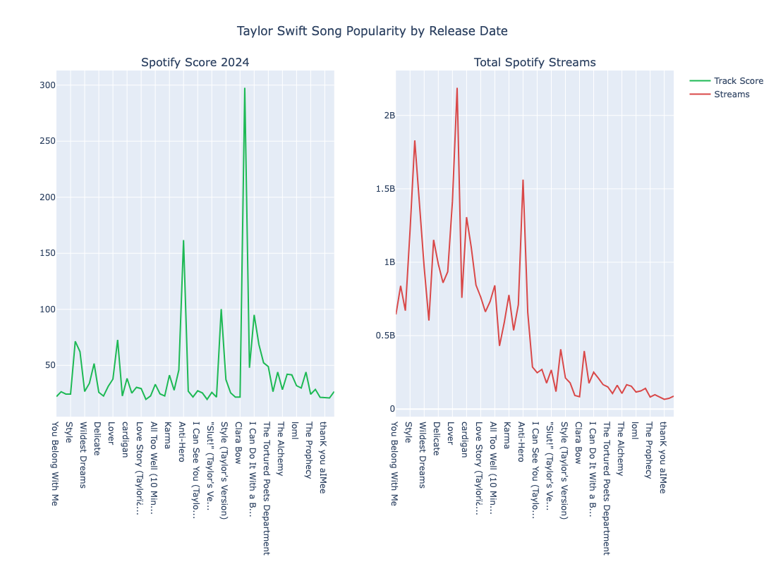
Choose Artist to Analyse
Choose an artist: Taylor

Slide 24
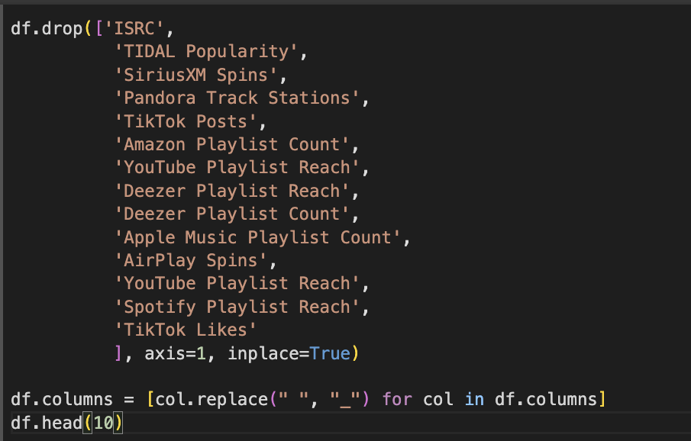

Slide 25

Insights and Conclusion
Statistical Summary
A statistical summary of numerical columns showed the central tendencies of the dataset. For instance:
Spotify Streams had a wide range with the top tracks accumulating billions of streams.
Metrics like Rank, YouTube Streams, and Shazam Streams provided insight into how different songs performed across platforms.
Conclusion:
The variability in monthly song releases has increased over the past five years. While releases used to be more common in the summer, there is now a shift towards fall and winter.
Track scores appear to be genuine and independent of other metrics, suggesting the metric's reliability.
Over time, the average and best track scores have improved, while the lowest scores have decreased, indicating a general improvement in song quality.
Being featured on playlists is not crucial for gaining streams. Spotify remains the most popular platform, increasing the chances of a song being played. Since songs perform differently across various platforms, distributing music across multiple services maximizes the potential for success. Additionally, streams don’t necessarily correlate with higher rankings, so focusing on streams or rank independently is advisable.
The way music is used varies significantly across social media platforms. Not all songs are universally popular. Spotify's top songs often feature captivating rhythms or catchy lyrics, while YouTube highlights tracks with visually compelling music videos. On TikTok, however, songs are frequently chosen for their ability to enhance video content—whether through unique sounds or lyrics that align with a creator’s narrative.

Slide 26
Insights and Conclusion
Key Findings from the Analysis:
1. Top Streamed Tracks
By sorting the dataset by Spotify Streams, the top 15 most-streamed tracks were highlighted. The analysis revealed that specific songs garnered significantly more streams than others, indicating that a small number of tracks dominate Spotify's platform.
Popular tracks included recurring artists who were consistently present among the top ranks.
2. Track Scores by Year
Visualizations were generated to display the average, best, and worst track scores for each year. This allowed for understanding how music has evolved over time and whether certain years produced better-performing songs.
The dataset suggests that explicit content has become more prevalent over time. However, there is no clear relationship between explicitness and a track’s popularity or score, challenging the notion that explicit lyrics directly contribute to success.
3. Platform-Specific Insights
Spotify: Most popular songs have a combination of catchy lyrics and rhythm, and the platform is heavily used for streaming. Recent streams have a greater impact on a song’s popularity than the cumulative total.
YouTube: Visual appeal plays a major role in determining song popularity, and music videos with engaging content tend to receive more streams.
TikTok: Tracks gain popularity not necessarily for their musical quality but for their alignment with trends and user-generated content, such as skits or challenges.
Shazam: This platform focuses on identifying songs, helping to boost song recognition and overall popularity.
4. Track Popularity and Playlists
An interesting finding was that inclusion in playlists is not essential for higher streams. The analysis suggests that playlist presence and total streams are independent variables.
5. Interest in Explicit Music
The analysis on explicit content revealed a growing trend toward releasing songs with explicit lyrics. However, the presence of explicit lyrics did not significantly affect a song’s performance on charts or its total streams.

Slide 27
Project Links
The project includes links to various resources.
1
Actual Spotify Portal
2
Spotify-EDA
3
Data Set
Link to the portal.
Link to the project file.
Link to the csv file.
4
READ-ME at Github
Link to the repository.

